Slide 1


Breakout Session
To develop base editing platforms
Xingxu Huang
ShanghaiTech University
Huangxx@shanghaitech.edu.cn

Slide 2
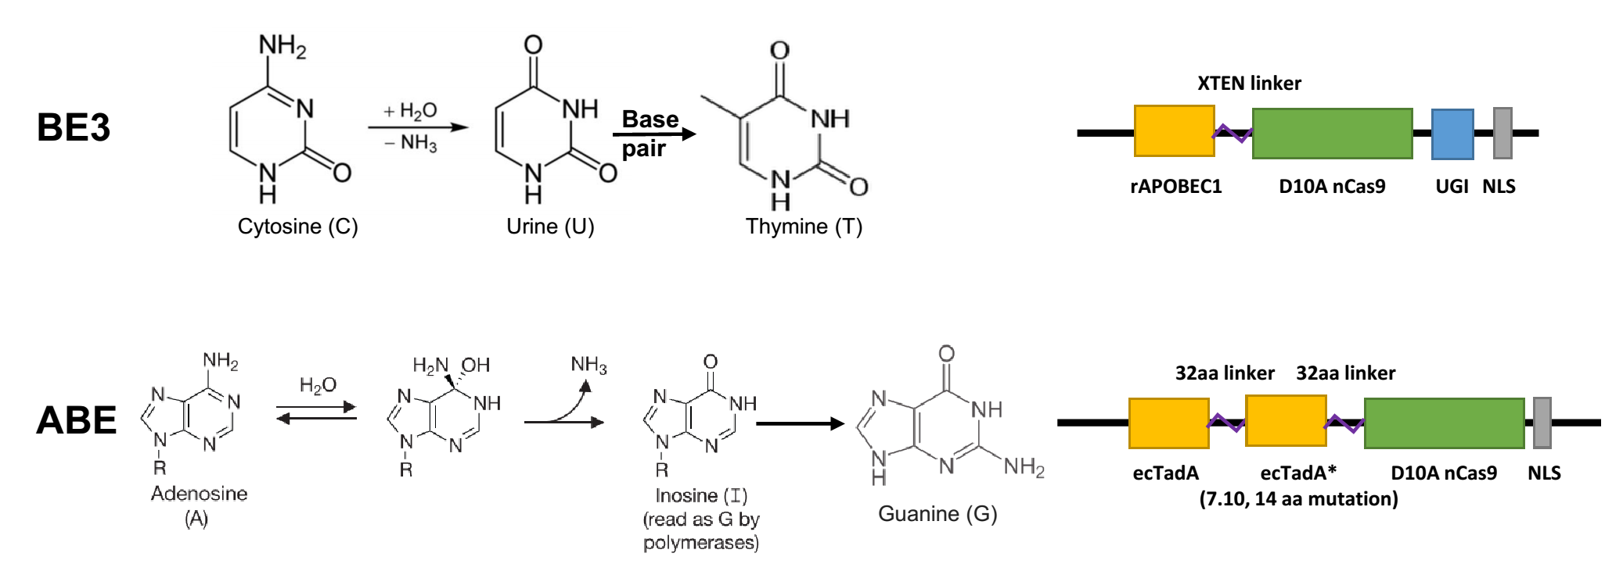
Base editing provides a more precise strategy
CBE: cytosine base editor
ABE: adenine base editor
Perform programmable editing of a target base in genome by deamination without double-stranded DNA cleavage.
Komor et al. Nature 2016; Gaudelli et al. Nature 2017

Slide 3
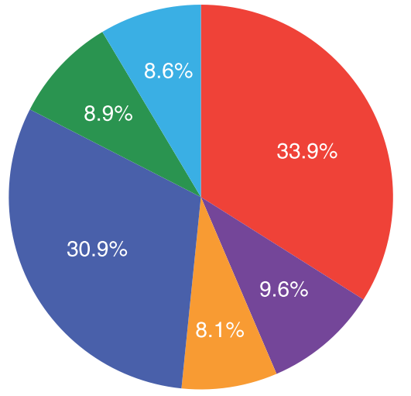
Base pair changes required to model naturally-occurring human SNPs
Modeled by A·T →G·C (67.0% by ABE)
Modeled by A·T →C·G
Modeled by A·T →T·A
Modeled by C·G→T·A (71.2% by CBE)
Modeled by C·G→G·C
Modeled by C·G→A·T
(Total 555,109,482)
dbSNP: https://www.ncbi.nlm.nih.gov/SNP/
Current editable naturally-occurring human SNPs
PAM | Corrected by ABE | Precise correction by ABE (10.5%) | Corrected by CBE | Precise correction by CBE (11.9%)
Total | 126,225,392 (100%) | 58,434,362 (100%) | 122,110,677 (100%) | 66,062,154 (100%)
NG (xCas9/SpCas9-NG) | 111,793,856 (88.6%) | 50,642,619 (86.7%) | 106,222,425 (87.0%) | 55,003,882 (83.3%)
NGG (SpCas9) | 36,118,948 (28.6%) | 15,657,121 (26.8%) | 31,682,039 (25.9%) | 15,035,152 (22.8%)
NGA (VQR SpCas9) | 44,155,390 (35.0%) | 16,213,326 (27.7%) | 45,180,539 (37.0%) | 21,815,188 (33.0%)
NGAG (EQR SpCas9) | 14,192,236 (11.2%) | 5,208,662 (8,9%) | 13,033,871 (10.7%) | 6,175,091 (9.3%)
NGCG (VRER SpCas9) | 2,240,558 (1.8%) | 977,152 (1.7%) | 1,667,471 (1.4%) | 673,810 (1.0%)
NNNRRT (KKH SaCas9) | 46,024,868 (36.5%) | 17,655,489 (30.2%) | 54,115,184 (44.3%) | 26,168,072 (39.6%)
NNGRRT (SaCas9) | 11,402,588 (9.0%) | 4,744,162 (8.1%) | 12,468,625 (10.2%) | 5,973,411 (9.0%)
Precise correction: only 1 editable base in edit window (from positions 4 to 7 for ABE, or 4 to 8 for CBE) (22.4%)

Slide 4
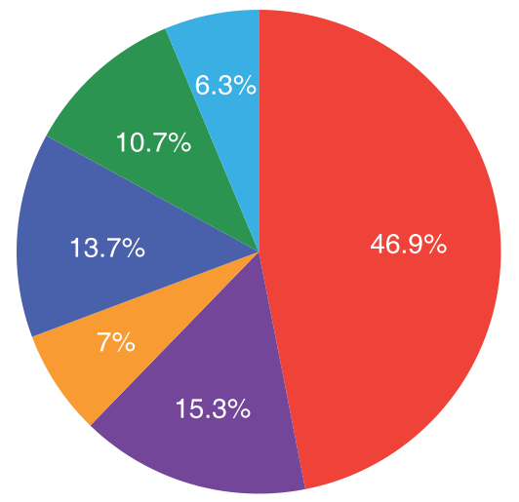
Base pair changes required to correct pathogenic human SNPs
Corrected by A·T →G·C (71.4% by ABE)
Corrected by A·T →C·G
Corrected by A·T →T·A
Corrected by C·G→T·A (79.1% by CBE)
Corrected by C·G→G·C
Corrected by C·G→A·T
(Total 31,743)
ClinVar: https://www.ncbi.nlm.nih.gov/clinvar/
Current editable pathogenic human SNPs
PAM | Corrected by ABE | Precise correction by ABE (21.5%) | Corrected by CBE | Precise correction by CBE (4.1%)
Total | 10,636 (100%) | 6,810 (100%) | 3,437 (100%) | 1,312 (100%)
NG (xCas9/SpCas9-NG) | 9,806 (92.2%) | 6,148 (90.3%) | 3,183 (92.6%) | 1,140 (86.9%)
NGG (SpCas9) | 3,853 (36.2%) | 2,357 (34.6%) | 1,236 (36.0%) | 383 (29.2%)
NGA (VQR SpCas9) | 3,524 (33.1%) | 1,916 (28.1%) | 1,395 (40.6%) | 416 (31.7%)
NGAG (EQR SpCas9) | 1,139 (10.7%) | 611 (9.0%) | 446 (13.0%) | 116 (8.8%)
NGCG (VRER SpCas9) | 394 (3.7%) | 235 (3.5%) | 178 (5.2%) | 51 (3.9%)
NNNRRT (KKH SaCas9) | 3,311 (31.1%) | 1,786 (26.2%) | 1,287 (37.4%) | 425 (32.4%)
NNGRRT (SaCas9) | 846 (8.0%) | 439 (6.4%) | 319 (9.3%) | 102 (7.8%)
Precise correction: only 1 editable base in edit window (from positions 4 to 7 for ABE, or 4 to 8 for CBE) (25.6%)

Slide 5
Challenges for BE
Base-editing product purity
Generation of indels
Off-target editing
Editing window and bystander edits
BE limitations
Delivery
Detection
Preparation
… …
Yin et al. Nat Rev Drug Dis. 2017, 16: 387-399.
Rees & Liu. Nat Rev Genet. 2018, 19(12): 770-788.
Notes:
5
建奎、广磊负责。

Slide 6
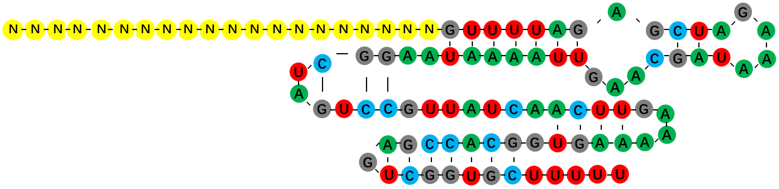
To improve BE
APOBEC
/TadA
5’
UGI
3’
nCas9
3’
5’
sgRNA
Rees & Liu. Nat Rev Genet. 2018, 19(12): 770-788.

Slide 7


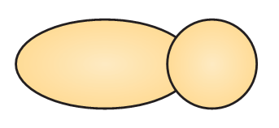
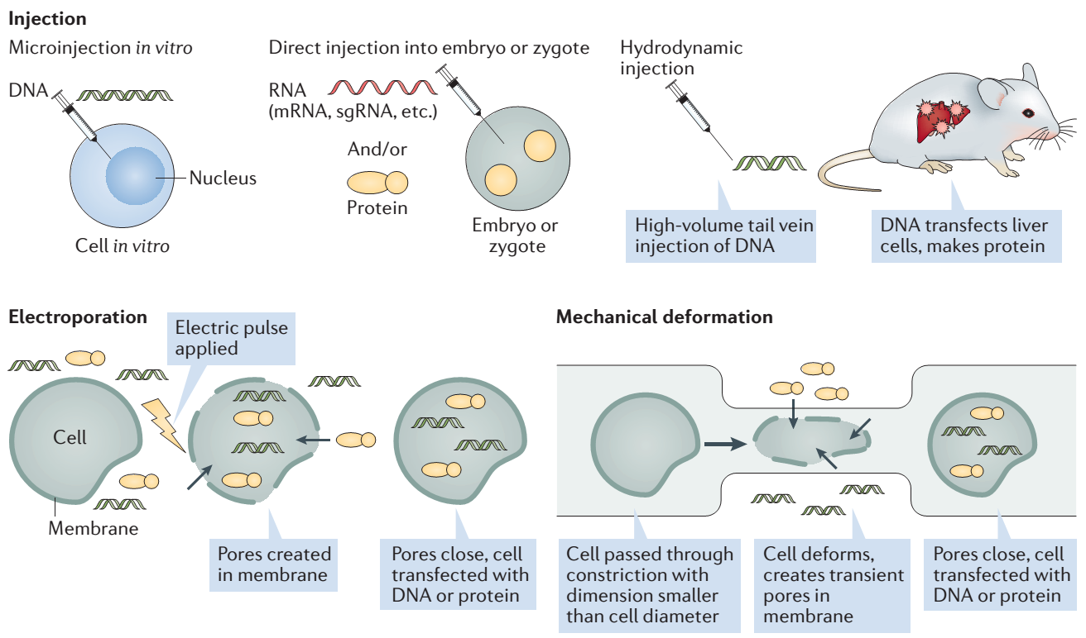
To test different delivery strategies
1. DNA
2. mRNA
3. RNP
Injection
Electroporation
Mechanical deformation
Yin et al. Nat Rev Drug Dis. 2017, 16: 387-399.

Slide 8
To develop different detections & analysis
BE3-mRNA+
sgRNA
Genotyping
Phenotyping
Collection
&
Detection
1
2 days
Tripronuclear embryos
BE3-mRNA+
sgRNA
Collection
&
Detection
2
2 days
…
Tripronuclear embryos
Individual blastomere

Slide 9
To develop base editing platforms
To perform genotyping & phenotyping
To analyze unwanted edit
… …
To develop new BE
To improve BE
Preparation
To prepare clinical qualified base editors
Delivery
Analysis
To establish best delivery form
BE toolbox

Slide 10

THANK YOU

